Slide 1

“Approach for Increasing the Product's Value and Offering Customers the Most Popular Features.”
Web & Social Media Analytics
Capstone Project
(On the Basis of A Mobile Manufacturing Business)
By Jatin Khatri, Shubhangi Purohit, Ashray Raj

Slide 2
AGENDA
Objective
Background
Key Findings
Recommendations
Appendix:
Data sources
Data methodology

Slide 3
OBJECTIVE
Provide major insights into the cell phone industry to help them develop a new product optimally.
To tweak the marketing strategies in order to add more value to the product and close the supply-demand gap.
The goal of social media is to generate leads , drive traffic to a website or make sales.
Social Media platforms provide businesses with a way to connect with customer and potential customers.

Slide 4
BACKGROUND
As the firm has just entered the mobile market three years ago, they want to understand their competitors and preference of their users; so that they can design their strategies accordingly.

Slide 5
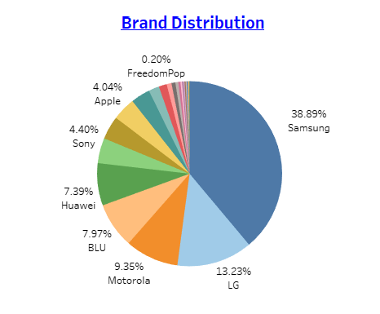
Market Capture by Brands
The most reviewed brands include Samsung, Motorola, LG, Huawei, HTC, Blu, Sony and Apple.
Since now we know how the market is controlled by these competitors, we can focus on the features and services provided by these brands.

Slide 6
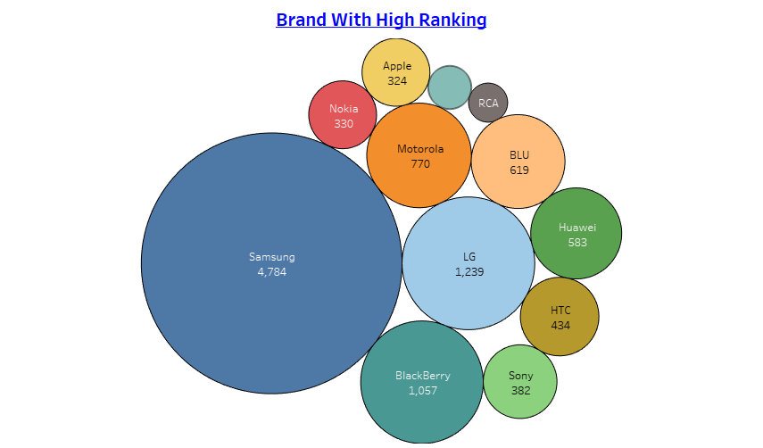
Brand with High Rantings
Cross Referencing the Customers’ Ratings with respect to different brands, we observe that even though Samsung controls the major sector of the market in terms of popularity, still other brands like LG, Apple, Blackberry, HTC, Huawei are positively related.
This means we must look at features provided by each brand.

Slide 7
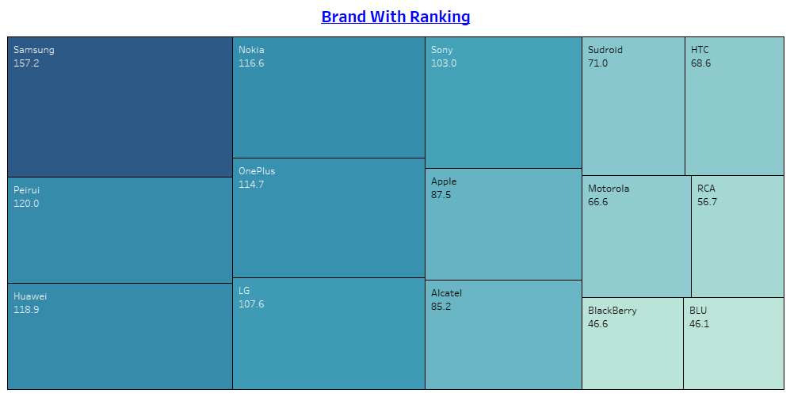
Varying Prices
The price preferred by the customers lies in the range of 150$ - 70$.
This should be the price segment that we should be targeting.

Slide 8
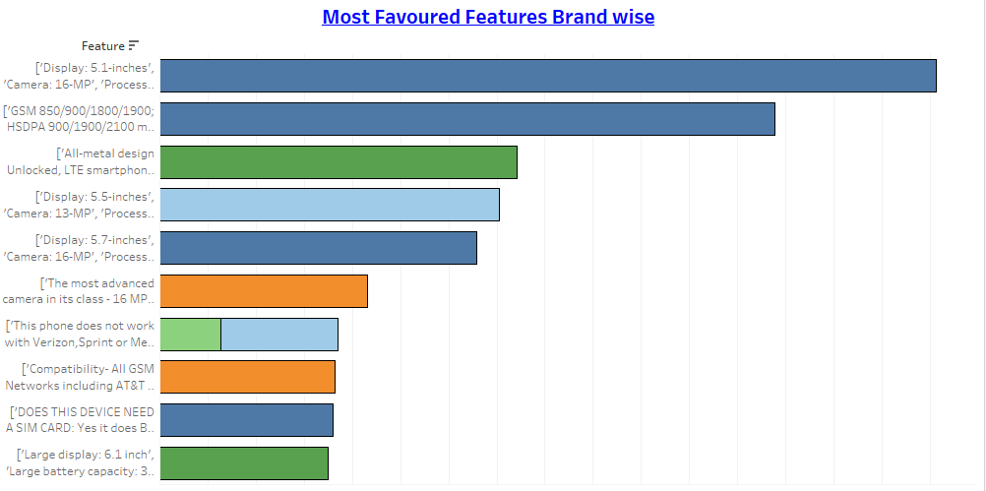
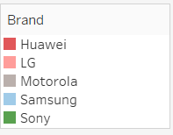
Most Favored Features Brand Wise!!
One of the most desired feature includes a Display size of 5.1 inches, Camera with a 16MP lens and a processor having 2.5GHz cloaking speed.
Also, the OS favored most is Android, this gives us an insight that the market we are focusing upon is majorly oriented to open-source platforms.

Slide 9
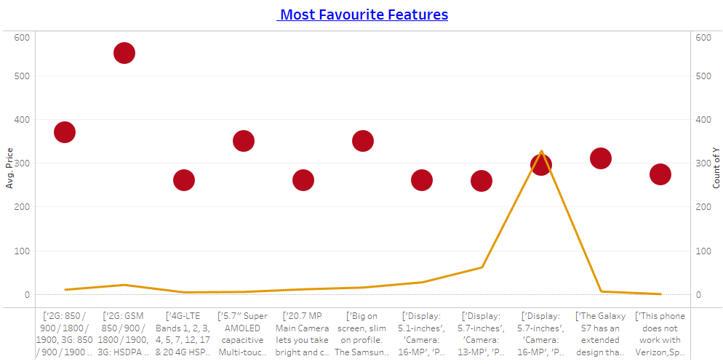
Most Favorite Features!!
Although there are many features which are reviews positively, but we see that not all the features are not cheap and far more than the price range which we are targeting(150$-70$).
The only feature which is favored as well as cost effective includes a display of 5.7 inches, a camera of 16 MP, 2.7 GHz processor along with Android OS.

Slide 10
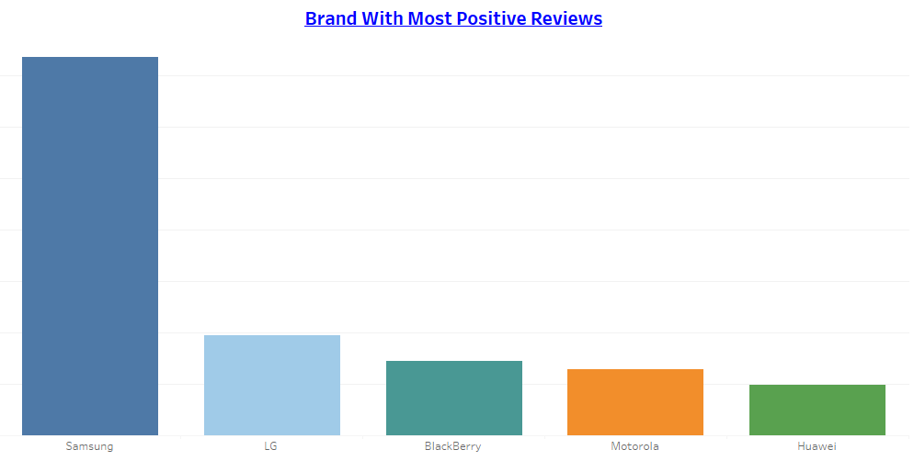
Brands with Most Positive Reviews
When it comes to finding a brand with the most positive reviews, it can be difficult to determine just one as it often depends on the industry and products/services being offered. However, there are a few brands that consistently receive high praise from customers and industry experts.
Samsung is one such brand that is often regarded as having a strong reputation for quality products and customer service. From their iconic Samsung S series to lower version it consistently receives high marks for design, functionality, and user experience.

Slide 11
RECOMMENDATIONS
Since now we know our competitors include brands like Samsung, Motorola, LG, BlackBerry, Huawei and Apple; we have to keep a keen eye on the services and features offered by them.
The market we are focusing on is a mid range price segment market since the price range preferred is in the range- 150$-70$. This gives us the segment we need to focus and introduce our range of products in.
Features we must have-
Android OS,
5.1-5.7 inches screen,
a processor of 2.7 GHz and
a camera of lens 16MP.

Slide 12
APPENDIX
Data Source: https://drive.google.com/drive/folders/1SbzDKj-WPeUd4rfFIIzBQ2nQpcqlapCx
Data Methodology:
Cleaning the data by summarizing rows and reducing columns.
Doing an exploratory analysis and formulating visualizations using Tableau
Using visualizations like Pie chart, Scatter Plot, Stacked bar chart, Heat map and Double Axis Chart.

Slide 13
THANK YOU

